Slide 1

Missing Persons Unit North Area
Haringey and Enfield
DS Carlington Mazhawidza
DS Colin Hedges
Edmonton Police Station

Slide 2
Missing Persons Team
2 Detective Sergeants
8 Constables
Shifts - 7 days cover between 0800hrs and 2200hrs

Slide 3
Missing People – London Profile
(2021/22) – 45, 103 missing investigations
Child Reports – (29,182) Adult Reports – (15,921)
Adult high risk themes: Suicide/Threat of Suicide, Self-Harm, Dementia, MH & A&E walkouts
Child high risk themes: Criminal Exploitation, this includes CSE & County Lines, Mental Health

Slide 4
MPS Response – Incident Development
Vast majority of service calls raised by MetCC – CAD Creation and sent to relevant BCU
Ops Manager (400) will have sight as gatekeeper – Can at this stage determine immediate actions where immediate risk is identified. 400 can also determine where a missing response is not appropriate but must seek research by RADT.
Otherwise – The CAD is picked up early by the Resource and Demand Team (RADT). They have a significant role, 24/7 – Informant engagement, research, confirmation of Risk Grading, progressive investigative action plan & Supervision – Low/Medium risk Progression under RADT Incident Manager.
High Risk cases – Initial investigation, basic prioritised actions and comprehensive Connect creation – Formal handover to Missing Person Unit/Local out of hours Contingency – Responsibility remains ERPT/RADT until handover completed.

Slide 5
Missing Policy Guidance
Missing Policy Guidance
Policy Guidance
Pre 48 hours RADT Risk Triage & Decision-Making – Ownership & Governance – Closure/Handover
Post 48 hours: MPU progression, Review, Case Management, Partnership & Strategy
Located/outcome, Prevention Interview, Referrals & Interventions

Slide 6
Operation Resolute
Philomena Protocol (October 2020) Children’s Social Care – Education, Accountability, underpinned by a Joint Responsibility Agreement – across 400+ care provisions
Affinity Protocol (September 2021) MH absconders, AWOL – NHS sites – Accountability, delivery of Trust’s ‘lost patient/AWOL’ response by them – Prevention & Risk-relevant reporting. All 9 MH Trusts, underpinned by Joint Responsibility Agreement – Policy acknowledgement/endorsement.
Dementia Framework (November 2022) An informed tactical, preventative approach – Reduce high risk, high vulnerability demand – Partner-owned. Coordinate prevention of incidents – GPS Tech devices, Herbert Protocol – Readiness from within community – Minimise occurrence/outcomes

Slide 7
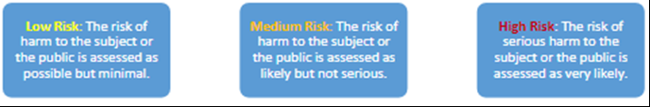
Risk Grading
Serious Harm – HO definition: risk which is life threatening and/or traumatic; from which recovery, psychological or physical is difficult or impossible
“Effective identification and recognition of risk elements that are very likely to cause serious harm through either physical or psychological trauma is essential for the MPS to accurately grade risk”.

Slide 8
Risk Elements
Risk Elements that may influence high risk:
Criminal: 2nd party influence, coercion, exploitation, victim of crime (DA/HBA) radicalisation, threat to wider public
Weather, time of day, Health: MH, life threatening condition, missed medication, impairment – communication or mobility.

Slide 9
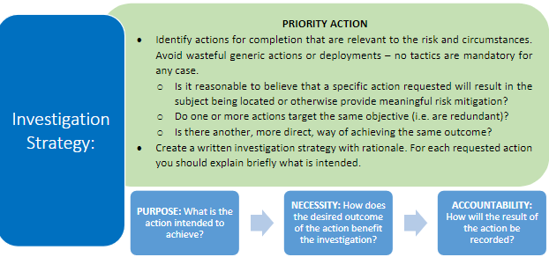
Approach to Investigative Strategy

Slide 10
Tactical Options
We carry out actions that help us find and safeguard missing people.
Some of the tactics are sensitive which cannot be shared here.

Slide 11
Incidents not Generating a Missing report
The BCU response may determine that some CADs classified as a Misper at the call handling stage are inappropriate for the Met to progress as such. This could occur on initial CAD receipt or as further understanding is obtained through informant contact, incident triage or other investigation.
In instances where it is believed to be justified that an incident will not generate a police missing persons investigation, intel checks relevant to the concern should be completed to support the decision making. Any incidents deemed to be inappropriately reported, or otherwise ‘not missing’, should be updated on CAD with a written record of decision making and rationale.
If applicable, the informant or relevant other persons (e.g. a family member) must be suitably updated. If an incident does not generate a police missing persons investigation interested parties should be left in no doubt about the decision that has been made.

Slide 12
Missing not Missing Guidance sing not Missing Guidance
‘Anyone who whereabouts cannot be established will be considered as missing until located and their wellbeing or otherwise confirmed.’
Under this definition, the circumstances of an individual’s whereabouts simply being ‘unknown’ could result in the expectation that police are responsible for locating them, regardless of the circumstances.
This is impractical, with unnecessary deployment being potentially damaging to the individual (e.g. breach of privacy), or by limiting the overall capability of police to respond effectively to missing persons (e.g. due to high levels of unnecessary and preventable demand).
To manage this, when an individual is reported missing, we must first consider whether there was any reasonable expectation or necessity for police to be informed at all.

Slide 13
Contact
Online reporting
101 non emergency
999

