Slide 1
Hate Crime
Leo Thorncroft
Prevent Community Engagement Officer
Leo.thorncroft@enfield.gov.uk

Slide 2

What is a hate crime?

Slide 3





Any criminal offence which is perceived by the victim or any other person, to be motivated by hostility or prejudice, based on a person’s:
religion or belief
race or ethnicity
disability
sexual orientation
transgender identity
Notes:
Crimes, but they’re taken more seriously. If someone hits you or attacks you for these things, it’s a hate crime. If they harass you, hate crime. Criminal damage, vandalising, hate crime!
HOWEVER, even if it isn’t a crime, it could be a hate ‘incident’. Report it either way.

Slide 4
Types of Hate Crime
Hate Crimes can take many forms, including:
Violent behaviour
Physical attacks
Touching sexually without consent
Stealing or damaging your belongings
Verbal abuse
Sending abusive or offensive messages
Acting in a threatening or intimidating way

Slide 5
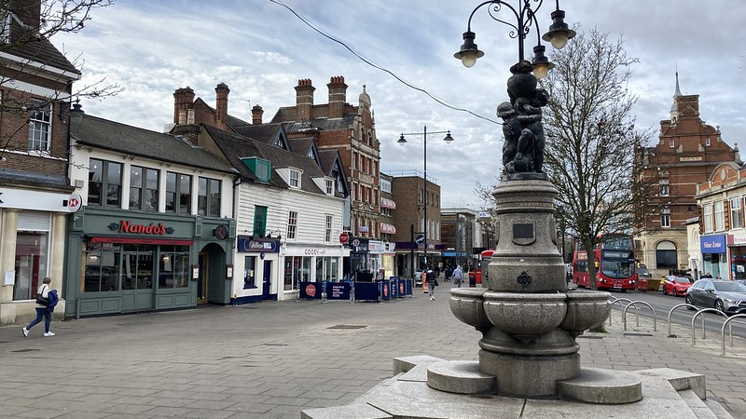
National & Local Trends

Slide 6
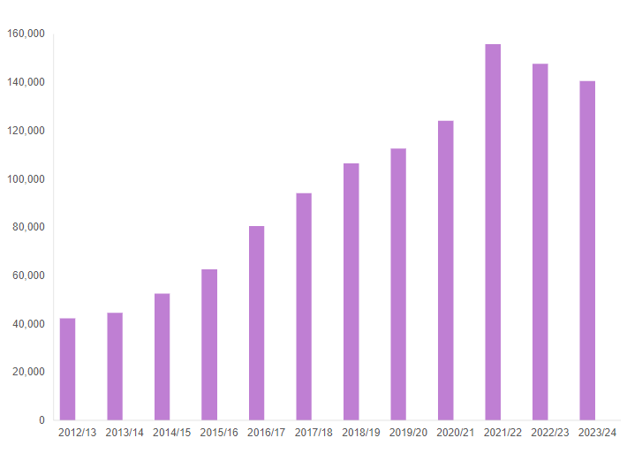

Slide 7
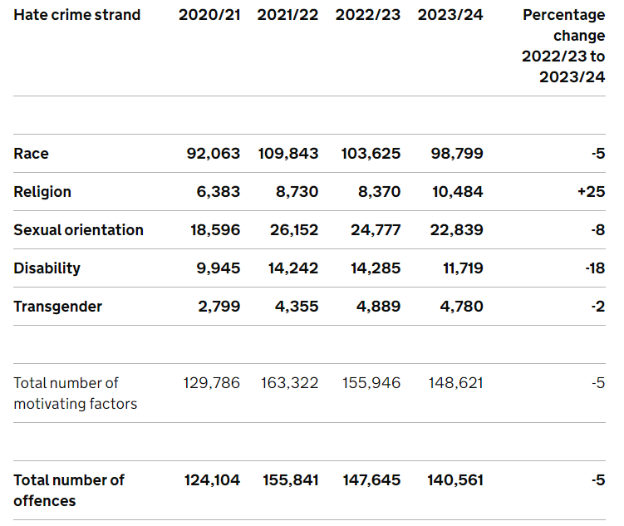

Slide 8
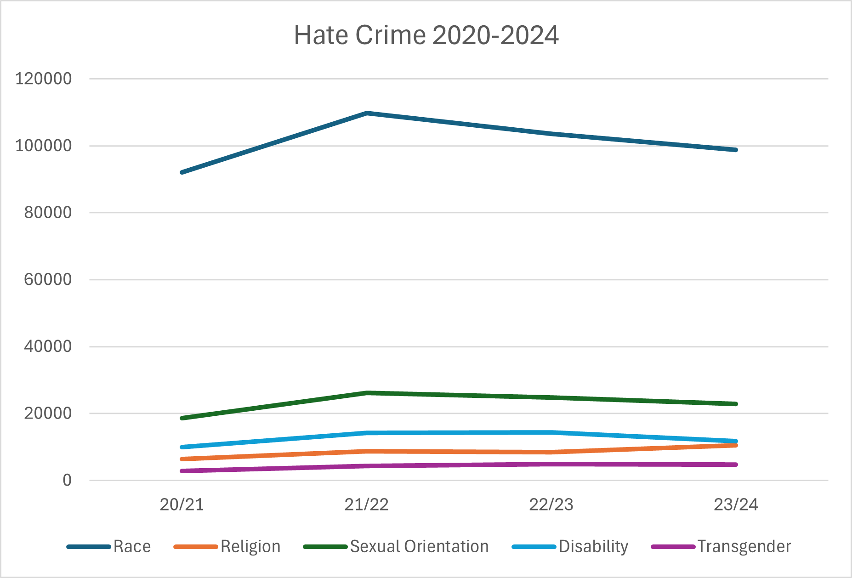

Slide 9
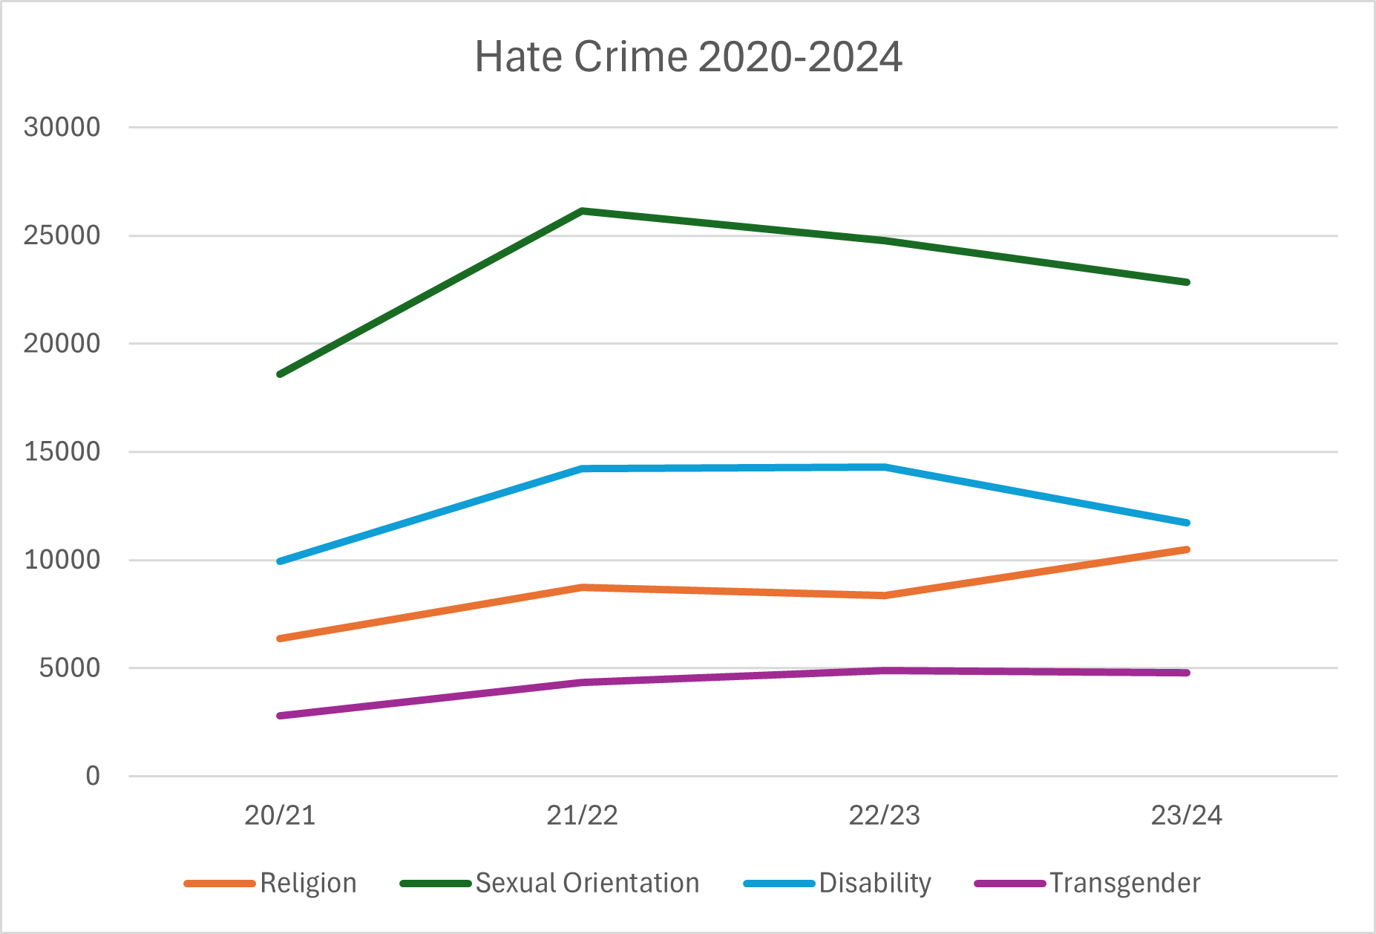

Slide 10
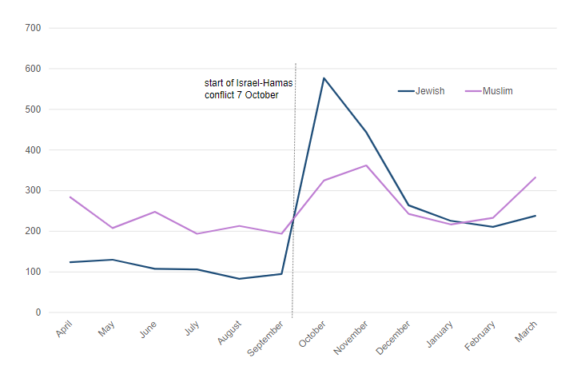
Notes:
Source: MET police dashboard

Slide 11
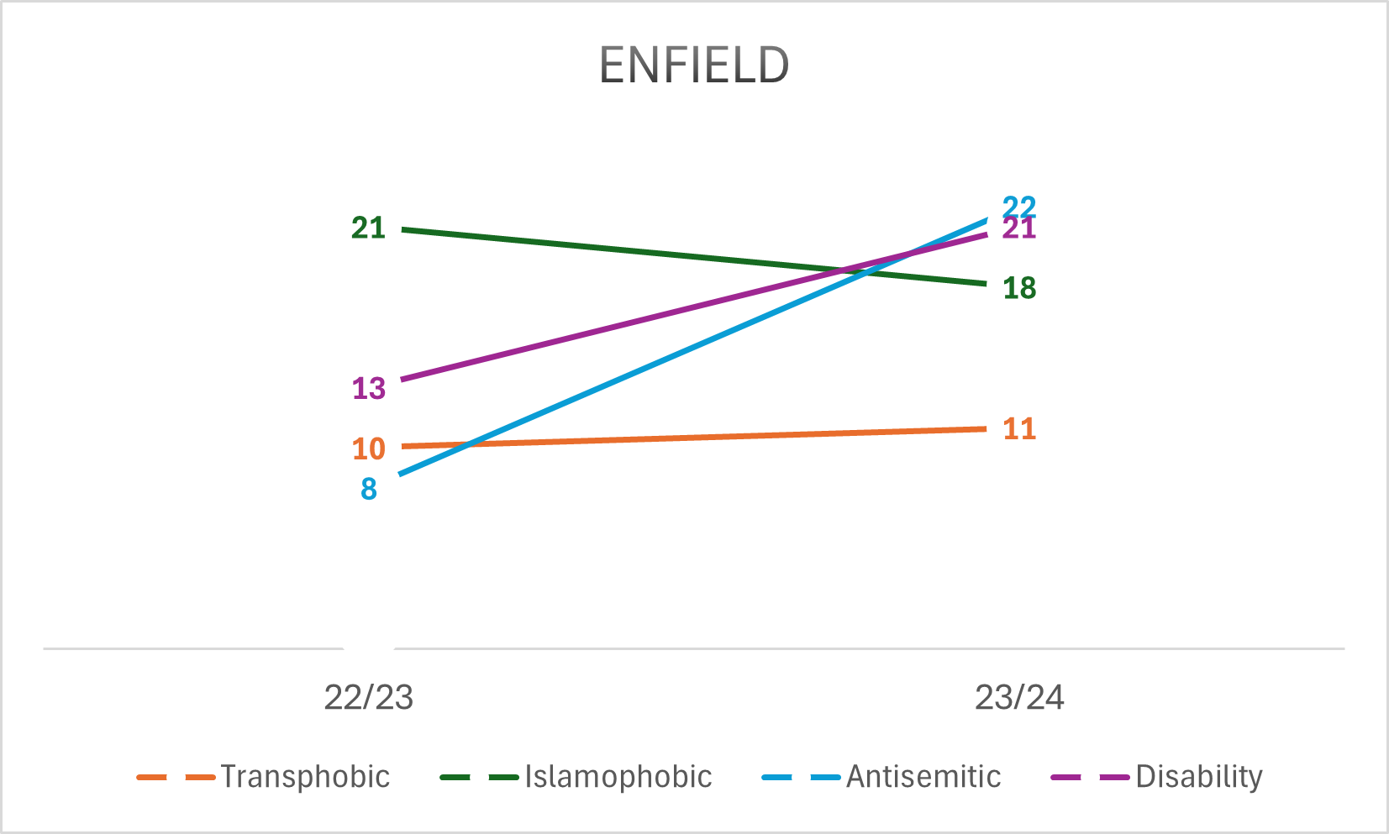
Enfield
658 hate crime offences in Enfield (April 23-Mar 24)
556 were racist crimes, compared to 575 the previous year (Apr 22-Mar-23)
74 homophobic, compared to 68 the previous year

Slide 12
Antisemitism
Uniquely conspiratorial: imagines the victims as being all-powerful, who are secretly controlling world events
New World Order
Blood Libel
Deep-rooted in culture, can be more veiled than other forms of hate but is evident to Jewish communities
CST is there for support
Notes:
Importance of reporting:
Better use of resources
Reveal problem
Encourage others to step forward
Help catch perpetrators and stop them from doing it again

Slide 13
Islamophobic
Misinformation around Southport was used by far-right agitators such as Tommy Robinson to stir up hatred
For certain far-right activists, Muslims have become their primary targets
The Great Replacement theory
Tell Mama are there for support
Notes:
Importance of reporting:
Better use of resources
Reveal problem
Encourage others to step forward
Help catch perpetrators and stop them from doing it again

Slide 14

Consequences

Slide 15
Victims of Hate Crimes
Motive of all hate crimes is primarily to instil fear and anxiety among a group (Stop Hate UK)
Diminish their sense of belonging to the extent of expunging them from the community and inflicting them with huge psychological damage in the process (Stop Hate UK)
Entire groups of people feel stigmatized and rejected, potentially resulting in community tensions and social isolation (Sussex Hate Crime Project)
Victims of hate crime often experience greater post-victimisation distress (including anxiety, depression, and withdrawal) than victims of equivalent non-prejudice offences (Iganski and Lagou, 2015)

Slide 16
Indirect Effects
Trauma of witnessing hate crime can have damaging effects on family members, particularly children (Williams and Tregidga, 2013; Zempi and Chakraborti, 2015)
Groups may conceal visible characteristics, avoiding certain places or being out at particular times, and reluctant to use certain services
Groups will be reluctant to interact with other communities due to fear and suspicion – which in turn can drive hatred
Can be the initial step towards extremism and more violent behaviour by perpetrators

Slide 17

What to do

Slide 18
Keeping Safe
Hate crime is a crime which must be treated seriously. Just like other crimes, it is never the victim’s fault for being targeted
The priority is increasing reporting, catching perpetrators, and making sure it does not occur so no one has to live in fear or modify their behaviour
There are, however, some things you can do to keep yourself safe

Slide 19
Keeping Safe
Let someone you trust know what your plans are
Look confident, even if you don’t feel it
Walk in well-lit areas at night, avoid dark shortcuts
Carry a personal alarm
Don’t let strangers into your home, and make sure that doors are locked
Keep valuables safe and out of sight
If something happens, get away as quickly as possible – SHOUT, draw attention to yourself
Tell someone as soon as possible – if it is an emergency, CALL 999 immediately

Slide 20
If something happens…
Get help and report it straight away
If the incident has happened and is not an immediate risk, ring 101 or report it online at True Vision (15 minutes). You can also report it at your local police station
Different organisations are available for support:
  Tell Mama – Islamophobia
  CST – Anti-Semitism
  Galop – Homophobia and crimes against LGBTQ+ community
  Stop Hate UK
  Victim Support – free and confidential help to victims of any crime
Notes:
Importance of reporting:
Better use of resources
Reveal problem
Encourage others to step forward
Help catch perpetrators and stop them from doing it again

Slide 21
In Enfield…
Hate Crime CMP, with representatives from the community, works with the police and local partners to ensure that hate crimes are dealt with and processed in an efficient way
Hate Crime Executive Forum, including community members, which works with the Local Authority to coordinate responses to hate crime and ensure transparency
My role includes educating different groups about the resources available and the importance of reporting

Slide 22

Questions?

