Slide 1




Safeguarding in Enfield for GRTBS communities- a discussion
Karen Maguire
GRTBS Lead Enfield Council
Striving for excellence
www.enfield.gov.uk

Slide 2

Working together today
Let’s be…
Curious
Mindful
Honest
Gently questioning
Supportive of learning
Inclusive of our differences

Slide 3
A lifetime of learning
Think about what you’ve learned about Gypsy and Traveller people at different stages of your life
What did you think or believe as a result?
Share reflections with the group

Slide 4
The Gypsy, Roma and Traveller (GRT) umbrella covers different groups:
GYPSY: Includes the various British Romany groups, Romanichal (English Gypsies), Welsh Kale and Scottish Romanies.
ROMA: Includes more recent Romani emigrants from mainland Europe.
TRAVELLER: This includes the protected ethnic groups of Irish and Scottish Travellers.
Roads from the past’ (Travellers Times) - https://www.youtube.com/watch?v=1bhBbMrF8Z0

Slide 5
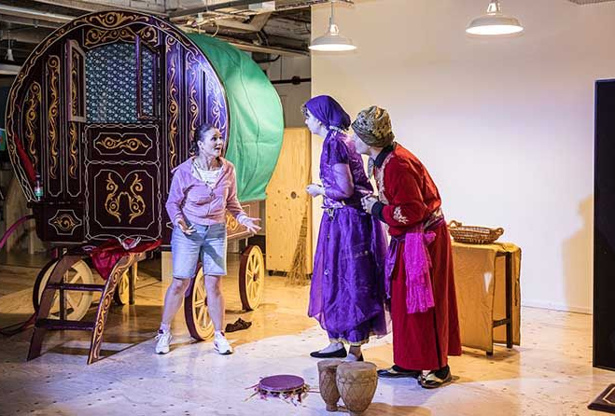
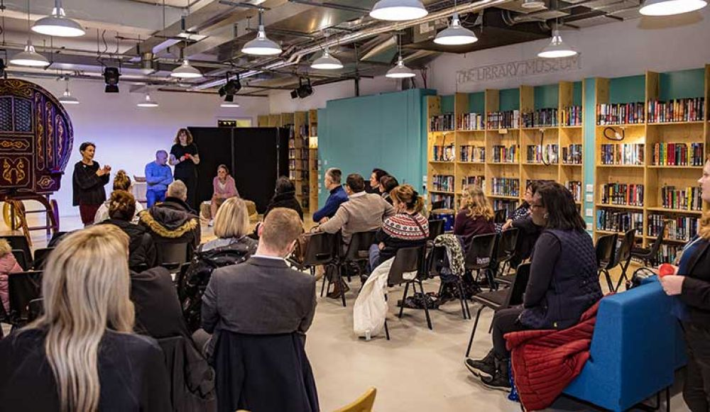
Gypsy and Traveller people in London
Romany Gypsies and Irish Travellers have been present in boroughs of London since at least the 1500s, predating an idea of a unified Great Britain.
From the last census data recorded we have 1800 GRT families in Enfield
We know from other data correlated this is more in the region of 6,000

Slide 6
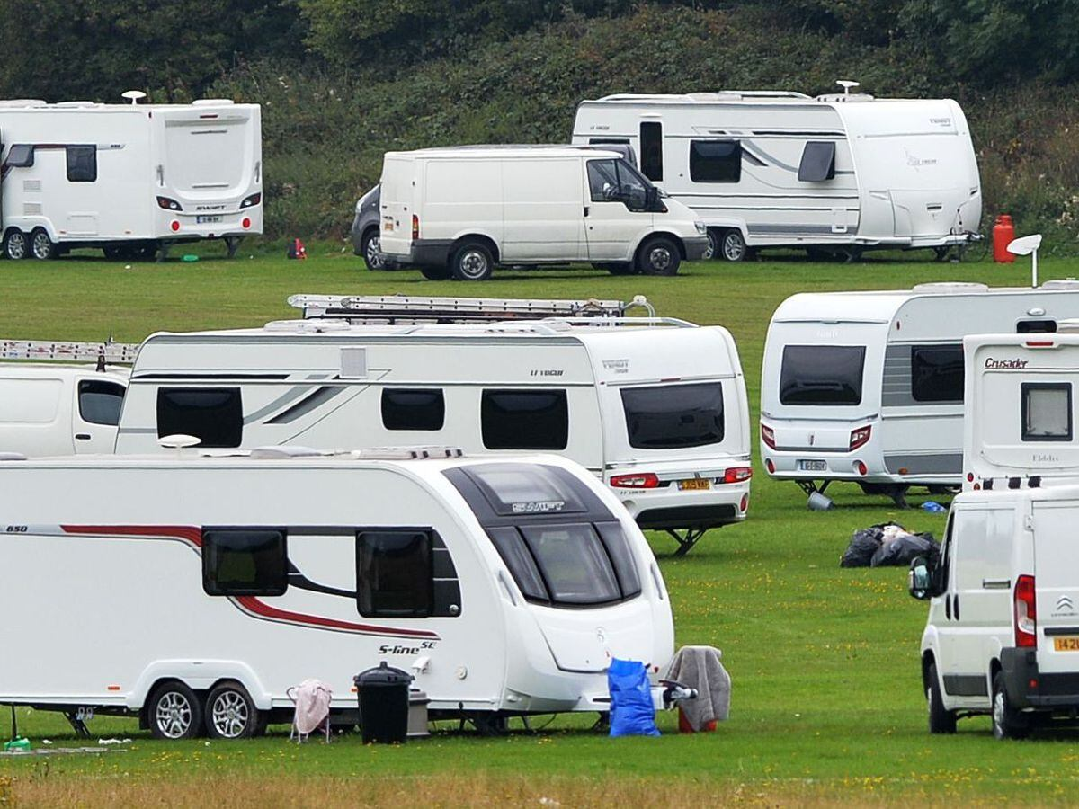
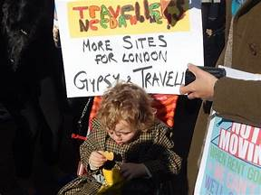
Social attitudes: ‘Shocking but not surprising’
Irish Travellers and Gypsies are the most disliked ethnic group in Britain according to a 2022 University of Birmingham survey
44.6% of respondents acknowledged negative attitudes towards this group, followed by negativity towards Muslim people (25.9%) and then Pakistani people (14.5%).
45% would be uncomfortable with a Gypsy or Traveller moving next door to them (2021 YouGov survey)

Slide 7
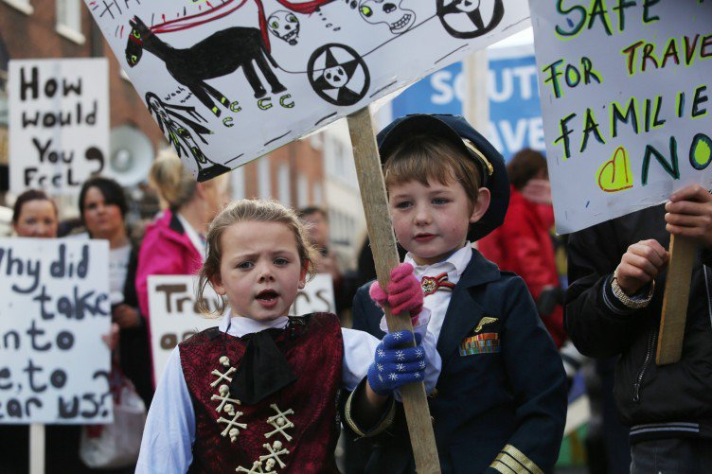
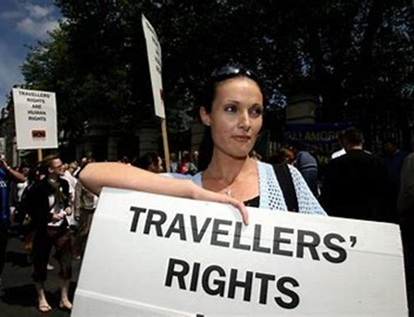
Gypsy and Traveller experiences of racism
62% of Gypsies and Travellers had experienced racial abuse, which was the highest out of all minority ethnic groups surveyed
Gypsy and Traveller people also reported the second highest percentage of experience of racial discrimination by the police (18.3%), more than three times the overall rate (5.7%).
Evidence for Equality National Survey (EVENS) 2023

Slide 8
Gypsy and Traveller experiences of hate crime
78% of people said incidents of hate speech/crime happen very often
94% of people have experienced exclusion and discrimination from and within services including health and education services
Source: Hate: ‘As regular as rain’ 2020 GATE Herts/Bucks New University
Notes:
87% have experienced abuse on social media
82% have experienced media incitement to racial hatred
Victimisation begins early in life: 78% experienced significant ‘hate-related incidents’ in school.

Slide 9
Impact on Gypsy and Traveller people
Worst outcomes of any ethnic group in Britain in relation to educational attainment, health and employment
Higher mortality rates - Traveller men and women live 10-12 years less than the wider population
65% of Gypsy and Traveller young people are affected by suicide in their families

Slide 10
GRTBS Project Board
To develop the borough’s strategic approach to Gypsy Roma and Traveller (GRTBS) communities in Enfield, by supporting the best possible quality of life for them by focusing on
Health and Wellbeing
Education
Community engagement
Site delivery
Community safety
Financial inclusion & employment
Equalities monitoring
Customer experience & journey
Heritage & Culture

Slide 11
How can we change our offer to GRTBS families – a discussion

Slide 12
Meet some of our stakeholders
GRTBS Community
London Gypsy Travellers
Friends Family Travellers
Traveller Movement
London Roma Support Group
Luton Roma Support Group
NHS
Mind
Samaritans
Greater London Authority
Branue Marketing Consultants
Members/ Cllrs
Enfield Wider Community
Citizen Advice Bureau Enfield
North London Hospice
Dr’s of the World
Gates Herts

Slide 13

Please feel free to get in touch
Thankyou
grt@enfield.gov.uk
02081320958

