Slide 1

Professional Curiosity in Practice

Slide 2
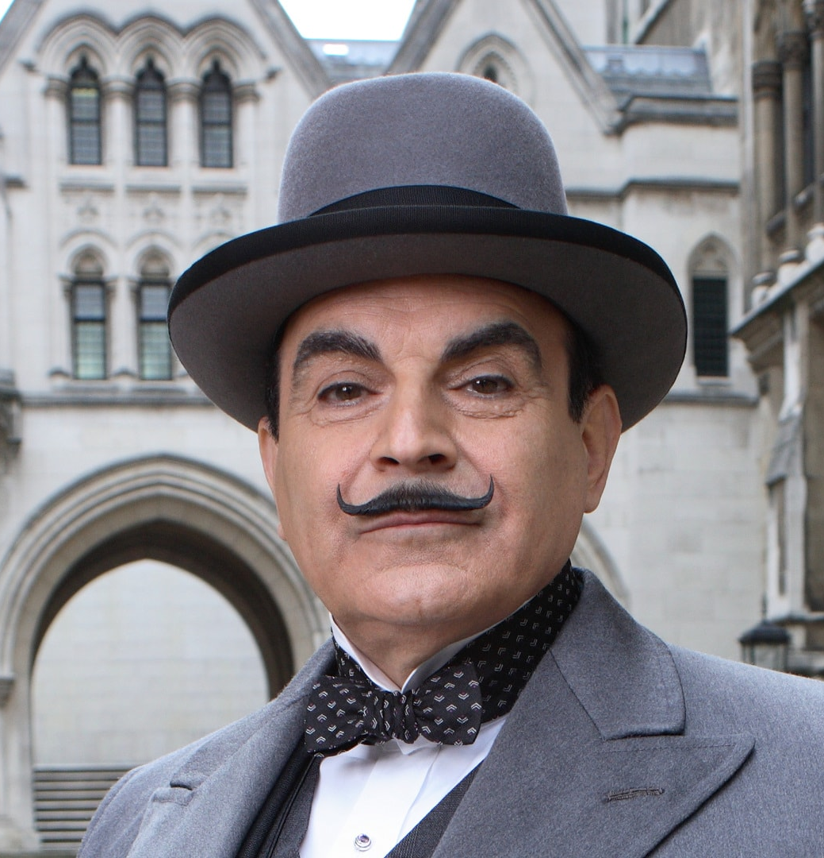
What is Professional Curiosity?
A process of bringing together information from various sources and agencies to build a more accurate picture of a situation with a family or individual and carers.
It involves:
Respectful nosiness
Testing hypothesis and not making assumptions
Triangulating information from different agencies, from the person, their carers and family and friends.
Learning about the person’s history
Being aware of our own personal biases, our feelings and anything impeding us.
Not accepting information at face value, obtaining more information from different sources.

Slide 3

Barriers to curiosity
“Normalisation”
Whereby we come to see behaviours and circumstances as “normal” and take them for granted, we stop questioning and therefore can overlook risk.
Confirmation bias
  We look for evidence that validate our preconceived ideas and overlook, filter out, or discount other information that might refute our theories.
The perception of the service user
  The person tells us they cope well, and we don’t want to question that. This may overlook risks, such as the person is coping because there are informal carers we aren’t aware of. Or they are only coping to a superficial extent.

Slide 4
Barriers cont.
The rule of optimism
Found as a factor in many reviews. This is our natural desire and hope that everything will be OK. It can lead to us rationalising away escalating risk. Or not looking into our feelings that things aren’t quite right.
Disguised compliance
The person or family give the appearance of co operating with services, ultimately with the aim of reducing our involvement.
This can also be a factor in Mental Capacity, a person is able to give all the right answers about what they plan to do, but they don’t have the capacity to act on it.
It can give false reassurance to professionals.

Slide 5
Barriers cont.
Not seeing the whole picture
Reviews have shown that we often just respond to the latest risk, and don’t look at the context or situation as a whole, or a series of accumulating risks.
This is referred to as the “start again syndrome”
Deferring to colleagues
Professionals are accountable for their practice, however managers or senior colleagues may apply pressure to “move on” and believe the risks are more minimal than the practitioner who is working with the case.
Not wanting to create more problems/more work..
Not asking further questions for fear of opening a “pandora’s box” which makes it all more complex, and we already have a big caseload, and not enough time.

Slide 6
Barriers cont.
Managing tension
Disagreement, aggression and anger from a person or their family or carers can divert the practitioner from the information they need to explore onto a different agenda. Or make it difficult to work out what’s going on in a situation.
Dealing with uncertainty
Vague information, retracted allegations, conflicting accounts. These are common in safeguarding and can require professional judgement and a need for further enquiries. Supervision is essential.
Our feelings and thoughts
Being tired or burnt out
Feeling rushed and short of time – realising it’s complex and you have to be somewhere else.
Wanting to rescue the person
Feeling our professional or personal boundaries are being challenged.

Slide 7
Maintaining Boundaries: Thoughts/behaviours to be concerned about
Anticipating, with uncommon excitement, a service user’s visit or appointment.
Viewing the person as in a position to advance your own position and fantasising as to how that would play out
Wishing that they were in some other type of relationship with you (e.g., your best friend or business partner)
Disclosing detail about your own life and expecting interest or nurturing in return
Trying to influence their political views or other beliefs
Relying on the person’s presence or praise to boost how you feel about yourself
Feeling entitled to all of the credit when their situation improves
Viewing them as among the central people in your life
Greatly resisting finishing involvement with the service user when it would be appropriate
Believing that you are the only person who can help a particular person or family.

Slide 8
Skills toolkit
Use your Motivational Interviewing Skills
OARS
  Open Questions
  Affirmations
  Reflections
  Summarise.
Don’t react (to emotional outbursts, blaming etc.)
Recognise and validate feelings, respond rather than react.
Manage time
  “We have 30 minutes today. Let’s see what we can achieve in that time.”
Use reflections to deflect from drama (changing tense, adding a hopeful comment)
  - “Everything’s gone wrong in my life.” “So it feels like lots of things are going wrong.”
Using structuring skills as well as listening skills

Slide 9
Skills continued
People need to know we can hear whatever their trauma is, even if we feel shocked / upset inside, or we feel judgmental
Projective identification- we become a container for their anxiety (we may experience this without even being conscious of it)
  Speak to yourself about how you are feeling: where is this coming from? You or the person?
  This can happen in high risk or review panels, and is always worth thinking about, if you notice heightened anxieties in the room
Be alert, is there something going on that makes you uneasy – think the unthinkable
  Look out for people who might be blocking access to practitioners
  Listen to those speaking on behalf of someone
Don’t take things at face value
Ask yourself why a person might not tell you the truth – always try and see them separately
Notice how family members speak to each other, or to carers

Slide 10
How Managers can support
Support practitioners to record why they’ve decided to close a case/take no further action
Support practitioners if they are tired, ask for a new set of eyes on a case
As “what if” questions
Support when a case needs longer than usual
Make sure that the case has been escalated to a risk panel, has had multi agency meetings etc, and information is being shared and collated
Monitoring workloads/burn out in the team. Offering support for stress or when staff feel too pressured.

