Slide 1



Mental Capacity Act
Striving for excellence
www.enfield.gov.uk

Slide 2
What is the Mental Capacity Act (MCA) 2005 – a quick history
MCA has been in force since 2007, it applies to England and Wales
MCA framework-It empowers people to make decisions for themselves wherever possible and provides framework to protect the people who lacks mental capacity to make their own decisions.
LPAs/Advance decisions: MCA also supports those who have capacity who want to choose to plan for their future, such as appointing a power of attorney or making an advance decision.
Code of Practice: All professionals have a duty to comply with the Act and its Code of Practice. It also provides support and guidance for informal carers.
The Act introduces a new criminal offence of ill treatment or wilful neglect of a person who lacks capacity (Section 44).

Slide 3
MCA - The 5 principles
The MCA has five key principles which emphasise its fundamental concepts and core values. These must be borne in mind when working with, or providing care or treatment for, people who lack capacity.
Presumption of capacity – every adult has right to make their own decisions.
Reasonable steps – person must be supported to make their own decisions
Unwise decisions – people have right to make what others may consider unwise decisions. They have different values, belief or preferences
Best Interests – anything done for person must be in their best interest
Least restrictive options – anything done must be least restrictive to their basic rights/freedoms.

Slide 4
Using the Act
Consent
Mental Capacity Act assessment
Best Interests Decision

Slide 5
Consent –
Starting point for all decisions.
Also the legal foundation for the majority of health and social care decisions.
Definition : The voluntary and continuing permission of the person to receive particular treatment or care and support.
A person evidenced to lack mental capacity cannot provide valid consent to treatment or care and support, even if they cooperate or actively seek it.
What information should be provided to the person?
The person needs sufficient information before they can decide whether to give their consent. The information needed is in three fold:
1: Nature – what care and treatment is being proposed and why?
2. Purpose – what are the benefits, negatives and alternatives
3. Consequences/risk -what will happen if the care or treatment do not go ahead.

Slide 6
Key points to remember regarding Consent
Consent can be written, oral or non-verbal. A signature itself does not prove the consent is valid. The most important point is to record the person’s decision and the discussions that have taken place.
Obtaining consent means providing the adult with appropriate information
Consent is given freely (no coercion/control)
No one can give consent on behalf of an adult who lacks capacity, unless the person holds a valid Lasting Power of Attorney or has been appointed as Deputy by the Court of Protection.
An adult with mental capacity can refuse all care and support and this cannot be overridden by the ‘duty of care’ of staff
If a person cannot give consent due to the person lacking mental capacity, then the Mental Capacity Act will come into effect

Slide 7
Mental Capacity 3 stage test Assessment
Part 1 The functional test of capacity: (NB time and decision specific)
Understand the information relevant to the decision (Nature +purpose + consequences/risk)
Retain the information (only long enough to make decision)
Use or weigh that information (Accept and take account of that information)
Communicate the decision (any form of communication)
Part 2 The diagnostic test of capacity: Person has an impairment of, or disturbance in, the functioning of the mind or brain (it does not matter if this is permanent or temporary).
Part 3 Causative Nexus must be established between the functional test and diagnostic test of capacity. This part determines whether the person’s inability to make the is decision because of the identified impairment or disturbance. Once you have identified an impairment or disturbance in the functioning of the mind or brain, it is important to decide whether the inability to make the decision is because of this impairment. This is known as the “causative nexus”.

Slide 8
Assessing mental capacity- what information does a person need to understand?
Case law shows what judges have explored when they are considering various decisions – Capacity as to residence, as to contact with others and on Care.
LBX v K,L, M [2013] EWHC 3230 (Fam) - the judge broke down what relevant questions were needed (39 Essex Chambers)
Other useful resources:
https://mylife.enfield.gov.uk/enfield-home-page/content/safeguarding/mental-capacity-act/

Slide 9
Proof
The burden of proof rests with the assessor. The assessor needs to prove the person they have assessed lacks mental capacity. The person being assessed does NOT have to prove they have mental capacity.
The standard of proof required is on the balance of probabilities. In other words, what is more likely than not. Objective reasons will be required to support your conclusions.

Slide 10
Key points for executive capacity
• Executive impairment can affect decision making capacity.
• It is often overlooked, resulting in potential exposure of a vulnerable person to risk.
• It can be very difficult to assess the effect of executive impairment on mental capacity for a number of reasons - repeated assessment of capacity, supported by collateral information and real-life functional assessment are recommended.
The term ‘executive functioning’ is not referred to in the Act or the CoP and should be included in clearly and explicitly in the Act
• If you have concerns that a person’s executive functioning may be affecting their decision-making capacity, this needs to be discussed with the MCA & DoLS Team 0203 855 6299

Slide 11
Where and which staff can use the Act?
There is no statutory limitation on where the MCA can be used (excepts DoLS). The Act can be used everywhere in England and Wales, including prisons. Some exceptions for patients detained under the Mental Health Act 1983 may apply.
All staff working with people who lack capacity are affected by the Act. In addition, relatives, carers and voluntary services must use the legislation if they provide support to those who lack capacity.

Slide 12
Best interests:
Best interests decision is only considered if the person has been assessed as lacking mental capacity.
Any decision made under this framework must be in the person’s best interest and least restrictive to their human rights and freedoms.
Checklist :The Act provides a statutory checklist that must be followed when making a best interests decision. The decision maker needs to consider the following points: Have regards to all relevant information, the person’s wishes/feeling, consult LPA/EPA attorney, Deputy appointed by the Court, consult others (family, support network and anyone who has interest in the welfare of P), consider least restrictive options, can the decision wait, and do not discriminate.
A balancing exercise, a balance sheet of positive and negatives connected to the decision is a good approach

Slide 13
What is a defensible decision? Some definitions
Kemshall (2009): ‘Decisions that will withstand the harsh scrutiny of hindsight bias in the event of a risk failure….informed, balanced, proportionate and just risk decisions’.
Cooper, 2011: ‘Critical, reflexive and careful judgements…with the fully considered evidence of incomplete knowledge so that you can defend and justify your assessments, plans and interventions’.

Slide 14
So, what is a defensible decision?
One that is evidence based , which uses all the information available/discoverable to you at the time (while being aware that we rarely have all the information);
Where the information has been thoroughly evaluated and analysed;
Which has weighed up different outcomes and options before deciding;
Which evidences the rationale for the decision , including anyone consulted;
Follows policy and legislative responsibilities/duties;
Is recorded in a way which evidences all the above.

Slide 15
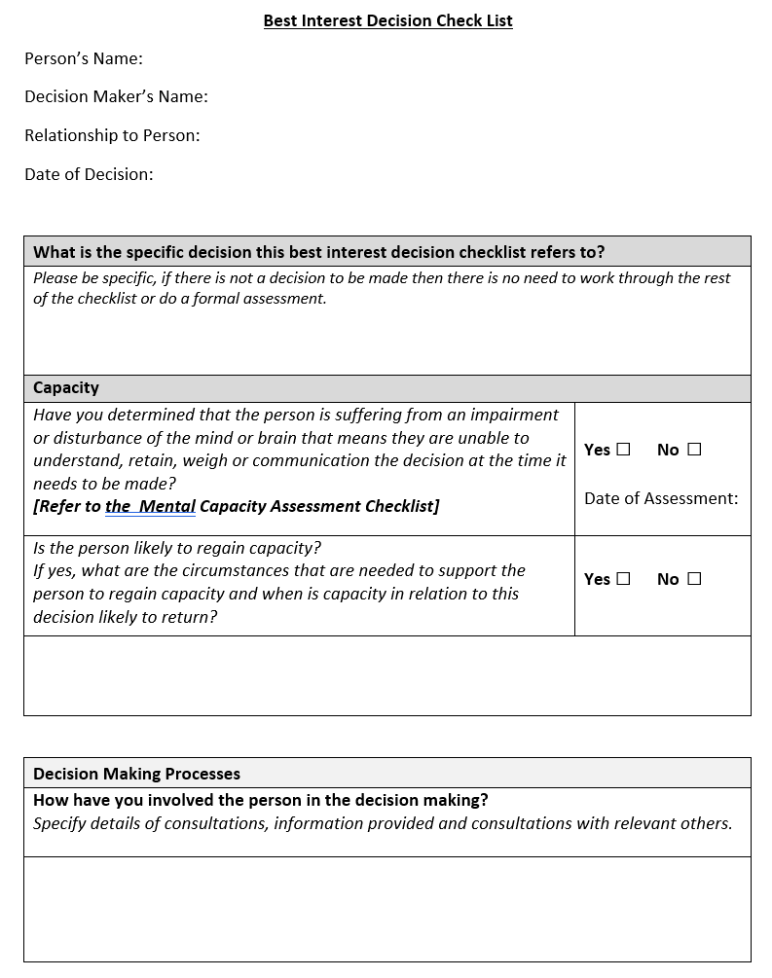
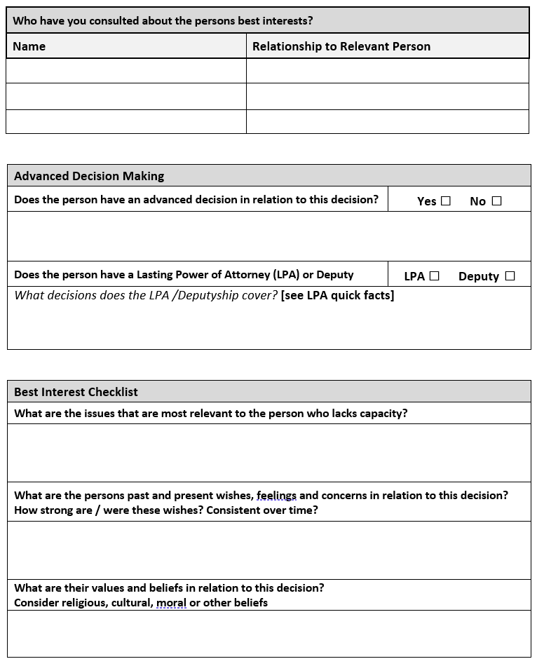
Best Interests Checklist example

Slide 16
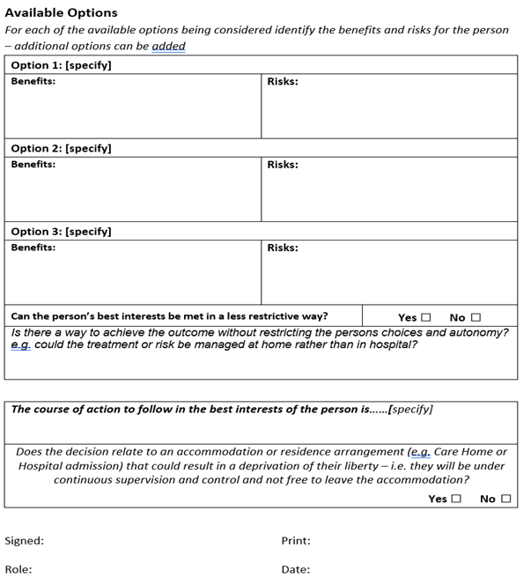

Slide 17
Legal protection for the decision-maker
By using the best interests checklist, the decision- maker is protected by the defence contained in section 5 of the Act which states they will ‘not incur any liability’ if they follow the Act properly.
A best interest decision/meeting therefore must be recorded appropriately.
Actions covered: being assessed (e.g. Care Act), personal care, washing, eating, help with mobility, education and leisure activities, buying necessary goods, helping to move home, health care/medical examination, giving medication, providing nursing care.

Slide 18
Top tips for making a defensible decision
Evaluate the information you are using: are there any gaps? How reliable are the sources?
Consider who you need to communicate with to make the decision: for example P, family members, professionals, other teams.
Ensure once the decision is made that it is communicated to the people/agencies who need to know.
Consider your own biases and preferences: might these be affecting your decision?
Use reflective supervision to evaluate your decision making and the impact of your values and experience.
Record your decision!
Ensure the rationale for your decision is clear in your recording. Evidence what other options have been considered.

Slide 19
Limits
The best interest checklist can be used to make all decisions around finances, health and social care, but it cannot be used to make decisions about:
voting
sexual relations
marriage
deprive person of their liberties
adoption or divorce
Signing/Executing legal documents (such as terminating tenancy/phone contracts)

Slide 20
Independent mental capacity advocates (IMCA)
If the person lacks capacity and has no suitable friend or family to support them, an IMCA must be appointed.
IMCA must be appointed for:
Serious medical treatment
Accommodation (28 consecutive days in a hospital or 8 consecutive weeks in a care home)
Deprivation of Liberty Safeguards
In addition, an IMCA may be appointed for:
Care reviews
Safeguarding adults from abuse cases

Slide 21
Quiz:
1. The term “causative nexus” means?
That there is an underlying cognitive cause that results in the person's inability to make decisions
Who is to blame in a car accident
What causes severe neck pain
An underlying cause which affects the person’s consciousness

Slide 22
2. Which of the following is NOT part of the 3-part test for assessing capacity?
Functional test to determine whether an individual is unable to make the decision
Diagnostic test to determine whether there is disturbance in the functioning of the mind or brain
Determining whether the person’s inability to make the is decision because of the identified impairment or disturbance
Cognitive test to determine whether the individual knows their date of birth

Slide 23
Q3 Identifying when individuals lack capacity to make decisions involves?
Asking complex questions and trying to catch them out
A test of the person's IQ
Taking them to another room and seeing if they can find their way back
Assessing whether they can understand, retain, weigh up and communicate information

Slide 24
Q4 The primary purpose of the MCA 2005 is?
Provide a legal structure for decision making and deciding whether someone has or lacks capacity to make their own decision
To determine how intelligent someone is
Safeguarding adults at risk of harm and abuse
Enable professionals to make decisions for people

