Slide 1


Council Housing
www.enfield.gov.uk

Slide 2
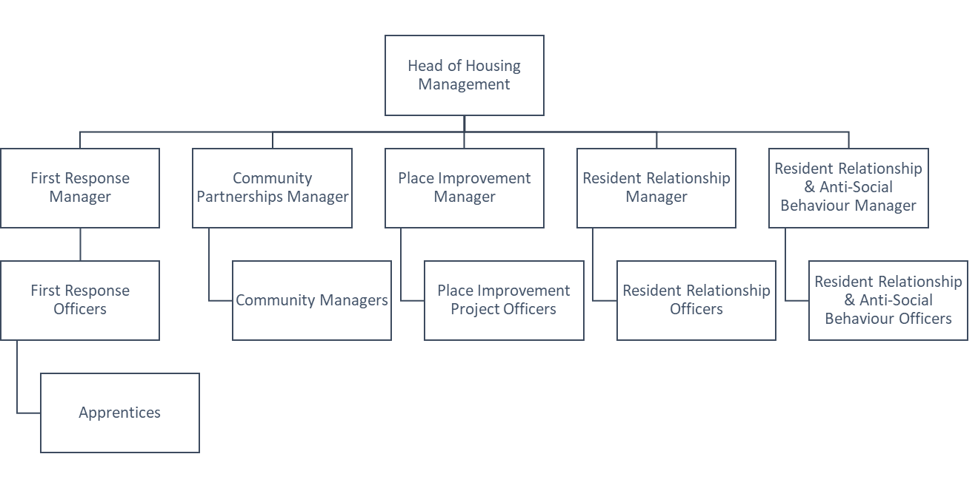
Housing & Regeneration

Slide 3
First Response Team
Geographic, patch-based service
Highly visible in uniform available for F2F contact
Block inspections
Fire Risk Assessment Housekeeping actions
Liaison and referral to people services teams
Monitoring cleaning and grounds maintenance contractors
Updates to notice boards
Community facing

Slide 4
Contact the First Response Team
First Response Team:
Patch Officer/Patch list
Duty Line: 0208 375 8008
Tenancy.council.housing@enfield.gov.uk

Slide 5
Community Partnerships Team
Targeted Estate Management Plans
Development and monitoring of local offers specific to the needs of the community
Attracting Inward Investment
Relationships with voluntary, statutory and the local business community
Sharing learning
Liaise with the Capital programme and Regeneration Teams to reconcile social value delivered through the supply chain

Slide 6
Contact the Community Partnerships
Team
Community Partnerships Team:
Patch Officer/Patch list
Duty Line: 0208 375 8008
Tenancy.council.housing@enfield.gov.uk

Slide 7
Resident Relationship Team
People Offer
Patchless and casework based- approximately 30-40 cases at any one time, cases will be managed on a time limited basis
Tenancy task work
  Housing applications
  Household amendment forms
  Successions and assignments
  Access
  Repairs
The nature of the work is such that the majority of the role will be delivered in client face to face environment supported by other channels
Working in partnership with voluntary and statutory agencies

Slide 8
Resident Relationship Team cont…
Person Centred Risk Assessments
Employment and financial resilience support
Manages complex multi-faceted issues from end to end including:
  Safeguarding
  Mental Health
  Substance Misuse
  Hoarding
  Disrepair
  These are just some examples of cases that we can support with

Slide 9
Contact the Resident Relationship Team
Resident Relationship Team:
Referrals via First Response team
Direct contact for assigned RRO
RROteam@enfield.gov.uk

Slide 10
Resident Relationship Anti-Social Behaviour (ASB) Team
Enfield Council has two teams responsible for managing ASB:
The ASB team based at the Civic Centre deal with high profile priority 1 issues such as – gangs, domestic abuse, drugs on estates and cuckooing. They can be contacted via email at ASBU@enfield.gov.uk
The RRO ASB team is based at the Edmonton Centre and deal with priority 2 issues. This includes playing music loudly, or at unreasonable hours but not day-to-day living noise, neighbour disputes, misuse of communal facilities.
  The team work closely with residents to create action plans and will update residents as frequently as agreed during the initial conversation with the complainant.

Slide 11
Behaviour We Can Investigate
Rowdy behaviour and drunkenness
Persistent dog barking or uncontrolled animals
Throwing objects or liquids from windows or balconies
Dealing or taking drugs and alcohol-related nuisance
Verbal abuse
Intimidation and harassment including stalking and hate crimes
Damage to property including vandalism and graffiti
Threats or acts of violence
Hate incidents motivated by age, disability, faith, race or sexual orientation
Inconsiderate or dangerous parking and abandoned cars
Environmental health issues such as dumped rubbish
Prostitution

Slide 12
Contact the Resident Relationship Anti-Social Behaviour Team
Resident Relationship Anti-Social Behaviour Team:
Referrals via online referral form: https://www.enfield.gov.uk/forms/report-antisocial-behaviour
Noise nuisance referral form: https://www.enfield.gov.uk/services/nuisances/noise-nuisance
Direct contact for assigned RRO ASB RROASBteam@enfield.gov.uk

Slide 13
Questions

