Slide 1
Human Papilloma Virus
Striving for excellence
www.enfield.gov.uk

Slide 2
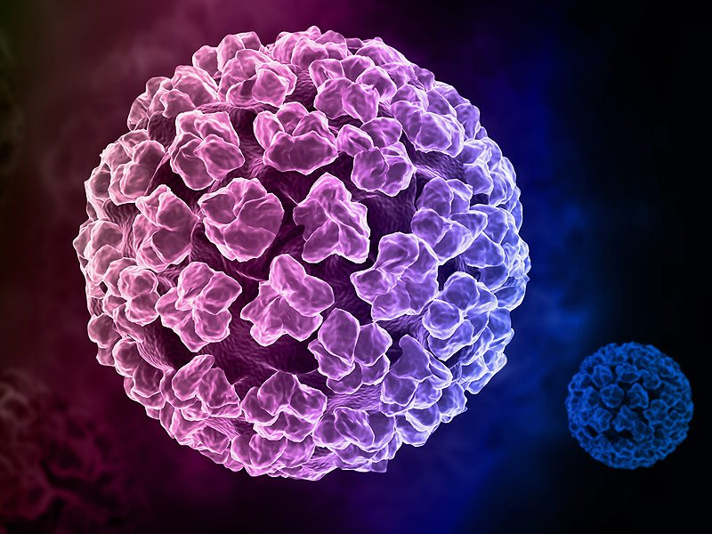
HPV molecule

Slide 3
What is human papilloma virus?
HPV has approximately 225 different types (strains). Two of those strains cause genital warts, these are known as low risk strains. Genital warts are harmless fleshy growths that grow on the genital and anal area.
The different types of the virus are very diverse and can cause warts, some mouth and throat cancers, and most vaginal, vulval, cervical, penile and anal cancers.
Four in five people (80%) who are sexually active will become infected with at least one strain of HPV in their lifetime, 90% of HPV infections will be cleared by the body’s immune system within two years.
In rare cases, HPV infections will not clear and an oncogenic (cancer causing) strain can cause abnormal cell growth which can develop in to cancer, these are known as high risk strains.

Slide 4
What is human papilloma virus (continued)?
Cancers which can be caused by HPV are: cervical, head and neck, rectal, penile, vaginal and vulval.
1 in 20 cancers worldwide are due to HPV, that is 5% of all cancers.
Human papilloma viruses cause more than 99% of all cervical cancers and cervical cancer is the most common cancer amongst women under the age of 35.
To prevent the spread of HPV, vaccinations are now available to young people from the age of 12 and are routinely offered in schools.
Girls and boys are eligible for a free vaccine up to their 25th birthday.

Slide 5
Why is the vaccination given at such a young age?
HPV infections can be spread by any skin-to-skin contact and are usually found on the hands, mouth and genitals.
This means the virus can be spread during any kind of sexual activity, including touching.
The HPV vaccine works best if girls and boys get it before they come into contact with HPV (in other words, before they become sexually active).
Getting the vaccine when recommended will help protect them from developing HPV related cancers for life.

Slide 6
So if the HPV vaccine is so great at protecting against cancer and genital warts why does everyone not have it?
Fear and mistrust of vaccinations.
Fear of needles and pain.
Young people and parents associate the HPV vaccination with being sexually active so do not feel it applies to their children.
Parents do not consent for their children to have the vaccine due to religious beliefs and associations with sexual activity.
Young people are scared to ask parents due to the fear they will think they are sexually active.
Some young people get one vaccination and miss their second and so have reduced protection, usually due to having forgotten.

Slide 7
How is the HPV vaccine given in schools?
In year 8 and year 9 all boys and girls are offered the HPV vaccination.
Usually the first dose is administered in year 8 and the second dose in year 9, some schools receive both doses in year 8.
Vaccination nurses will attend the school to administer the vaccinations.
The World Health Organisation (WHO) recommends the HPV vaccination and deems it safe.

Slide 8
What else can we do about HPV and cervical cancer?
The vaccination is a way to protect against HPV related cancers.
If vaccinations are missed in school speak to your GP about getting it for free up to the age of 25, after the age of 25 it can still be accessed but you’d need to pay for it privately, it is approximately £500. The vaccination however is less effectively the later in life it is given.
Just before women turn 25 they are invited for their first smear test, smear tests check for any HPV related abnormalities in the cervix, early detection is key, if cell abnormalities are found you will continue to be monitored till your immune system either clears the virus causing the abnormalities or the cells need to be removed. This is all done to prevent cancer developing.
Attending smears is very important.

Slide 9
Conclusion
The vaccination is safe and effective at protecting against many cancers and genital warts (STIs) for boys and girls.
The earlier it is taken in a persons life the more effective it is.

Slide 10
HPV Video Link
https://youtu.be/U75BSj1sUIc

Slide 11
Services in Enfield
Clinics in Enfield:
https://www.echoclinics.nhs.uk/
Order online testing kit:
https://www.shl.uk/
Sexual health information at:
https://www.enfield.gov.uk/healthandwellbeing/sexual-health
Condom scheme information
https://www.enfield.gov.uk/healthandwellbeing/sexual-health/condom-scheme
To request a c-card email sexualhealth@enfield.gov.uk

Slide 12
For more information….
For ANY RSE, sexual health and C-Card related queries email sexualhealth@enfield.gov.uk

