Slide 1
Contraception and Staying Safe
Striving for excellence
www.enfield.gov.uk

Slide 2
What we’ll cover today
Contraception & emergency hormonal contraception (morning after pill)
Sexting
Grooming
Child sexual exploitation
C-Card and clinic opening times

Slide 3
Disclaimer
In this presentation, we will be discussing topics to do with staying safe – including sexting, grooming, and sexual exploitation.
If for any reason you would like to speak to someone further, please do let us know, and if you need a breather – feel free to take a break outside.

Slide 4
Ground rules
Respect your peers
Listen when someone is speaking
Turn off your mobiles and other devices
Don’t tell other people’s stories
Confidentiality
Feel free to ask questions ☺

Slide 5
How to set ground rules with young people
Establish a safe space – introduce the aims of the session and explain that for some people these can be challenging or sensitive topics to talk about.
Explain the importance of creating a learning environment in which everyone feels safe and respected and able to share their views and listen to others.
Ask participants to call out ideas and suggestions and write them on a board / flipchart.
Or give each participant a post-it note and ask them to write one thing that they want everyone to do to create a learning environment in which they can participate.
Ensure that your space is LGBT+ inclusive.
Display the agreement.
Refer back to the agreement each session of when you feel is appropriate.

Slide 6
Icebreakers, energisers and warm up activities
Icebreakers, energisers and warm up activities – encourage participants to have fun and interact with each other before the session start.
Ideas for this are:
Would you rather? We will do this next…
Cross the circle. Encourages participants to share view and experience with others in a way that feels safe to them. E.g. cross the circle if you
Have a brother or sister
Laughed out loud this morning
Like the taste of marmite
Have ever cried form being so happy
Have lied
Have argued with someone
Have made a sexist comment yourself
For more ideas go to https://insight.typepad.co.uk/insight/icebreakers_and_games/

Slide 7
Would you rather?
Be invisible or be able to fly?
Sit on a beach for a week or go to New York?
Wear someone else's dirty underwear or use someone else's toothbrush?
Know when you are going to die or how you are going to die?
Only wash your hair once a year or brush your teeth once a year?
Fall in love or win the lottery?
Snog a complete stranger or lick your friends’ face?
Give up your mobile phone or your best friend for a whole year?
Lie in a bed of spiders or a bath of slugs?
Always say out loud everything you are thinking or never be able to speak again?
My son’s question – would you rather be in prison for 3 months or lockdown for 6 months.

Slide 8
Statutory RSHE in schools
Relationships, Sex and Health Education (RSHE or PSHE) is now compulsory in schools
DfE guidance can be found here
Contraception – what pupils should know by the end of secondary school
Intimate and sexual relationships, including sexual health
That all aspects of health can be affected by choices they make in sex and relationships, positively or negatively, e.g. physical, emotional, mental, sexual and reproductive health and wellbeing.
The facts about the full range of contraceptive choices, efficacy and options available.
The facts around pregnancy including miscarriage.
That there are choices in relation to pregnancy (with medically and legally accurate, impartial information on all options, including keeping the baby, adoption, abortion and where to get further help).
How to get further advice, including how and where to access confidential sexual and reproductive health advice and treatment.

Slide 9
Statutory RSHE in schools
Sexting, Grooming, Child Sexual Exploitation – what pupils should know by the end of secondary school
Online and media
Pupils should know
Their rights, responsibilities and opportunities online, including that the same expectations of behaviour apply in all contexts, including online.
About online risks, including that any material someone provides to another has the potential to be shared online and the difficulty of removing potentially compromising material placed online.
Not to provide material to others that they would not want shared further and not to share personal material which is sent to them.
What to do and where to get support to report material or manage issues online.
The impact of viewing harmful content.
How information and data is generated, collected, shared and used online.
Being safe
The concepts of, and laws relating to, sexual consent, sexual exploitation, abuse, grooming, coercion, harassment, rape, domestic abuse, forced marriage, honour-based violence and FGM and how these can affect current and future relationships
How people can actively communicate and recognise consent from others, including sexual consent, and how and when consent can be withdrawn (in all contexts, including online).

Slide 10
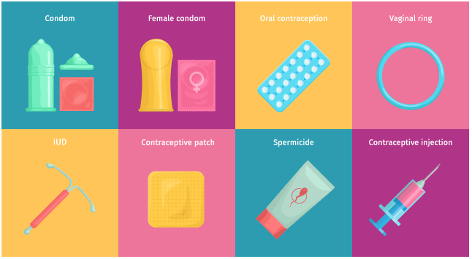
Contraception

Slide 11
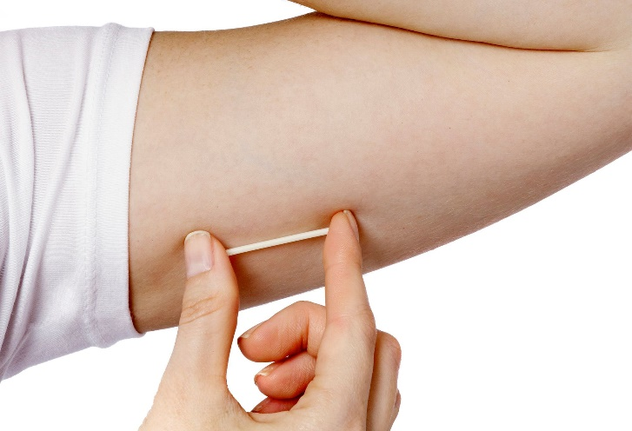
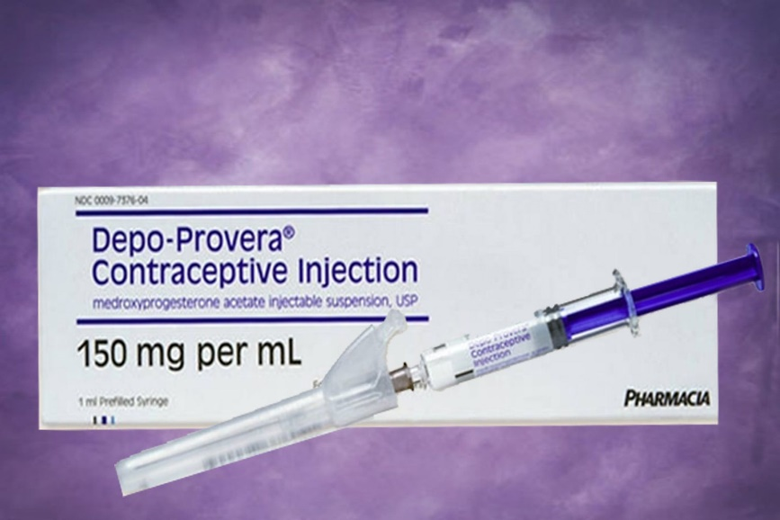
Long Acting Reversible Contraception (LARC)
Implant
The implant is a method of LARC contraception. It is a matchstick sized rod of plastic inserted into the upper arm which releases progestogen - a hormone to prevent pregnancy.
Lasts 3 years
Over 99% effective
Injection
The injection releases the hormone progestogen which works to control your fertility.
Injection every 8, 12 or 13 weeks
94% - over 99% effective

Slide 12
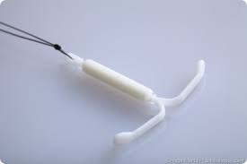
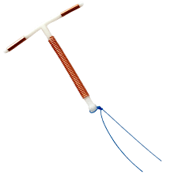
Long Acting Reversible Contraception (LARC)
IUS (Intrauterine system)
The IUS is a small T shaped plastic device that contains the hormone progestogen to control your fertility. The device needs to be fitted by a trained nurse or doctor.
Lasts 3-5 years
Over 99% effective
IUD (Intrauterine device)
The IUD is similar to the IUS but it does not release hormones, it releases copper into the womb. It can also stop a fertilised egg from implanting. The device needs to be fitted by a trained nurse or doctor. The IUD is the only form of LARC contraception which is non-hormonal.
Lasts 5-10 years
Over 99% effective

Slide 13
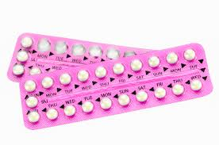
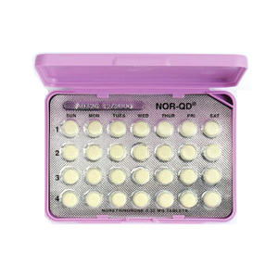
Hormonal Methods
Combined Pill
The combined pill is what is commonly known as ‘the pill’ it gets its name because it contains two hormones; progestogen and oestrogen.
Taken daily for three weeks, followed by a 7 day break
91%-99% effective.
Progestogen-Only Pill (mini pill)
Progestogen only pill, this is taken every day with no break.
Taken daily.
91%-99% effective.
Notice how methods of contraception become less reliable when they depend on people having to remember to take them.

Slide 14
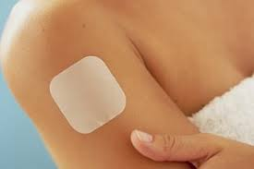
Hormonal Methods
Contraceptive vaginal ring
The contraceptive vaginal ring is a soft, flexible, plastic ring that goes into the vagina. It releases the hormones oestrogen and progestogen into the bloodstream to prevent pregnancy by controlling your fertility. The vaginal ring is less common in the UK.
Replaced every four weeks – worn for three weeks, followed by a week off.
91%-99% effective.
Contraceptive patch
This is a 5cm by 5cm beige patch, applied to the skin like a plaster. It releases the hormones oestrogen and progestogen through the skin. This prevents pregnancy by controlling your fertility.
Replaced once a week for three weeks, followed by one week off.
91%-99% effective.

Slide 15
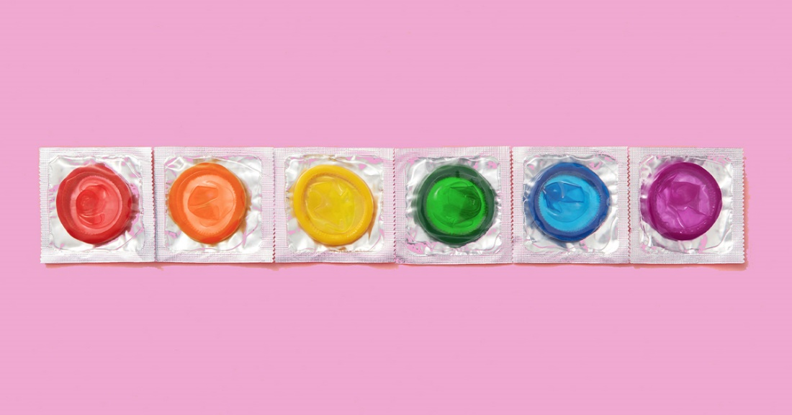
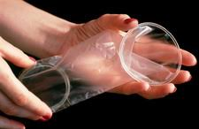
Barrier Methods
Barrier methods are the only way to prevent the spread of sexually transmitted infections as well as preventing pregnancy.
Condoms
Condoms are made of very thin latex (rubber) and are designed to cover the penis in order to stop skin to skin contact and from sperm entering the vagina during ejaculation.
Single use.
82%-98% effective.
Internal or Female Condom (Femidom)
Female condoms are less common than condoms but it is good for people to be aware that they do exist. Instead of covering the penis they inserted into the vagina.
Single use.
79%-85% effective.

Slide 16
Emergency Hormonal Contraception (The Morning After Pill)
Emergency contraceptive or “the morning after” pill works by delaying ovulation (release of an egg) and by thickening the mucus lining at the cervix therefore preventing sperm getting in to the uterus.
Levonelle (Levonorgestrel) can be taken up to 72 hours after unprotected sex, and is more effective the earlier that you take it. Young people in Enfield can access emergency hormonal contraception for free at sexual health clinics and in certain pharmacies.
Ella One (Ulipristral Acetate) can be taken up to 120 hours (5 days) after unprotected sex. It is free at sexual health clinics, or at pharmacies with a prescription from your GP.
The IUD coil is made from plastic and copper. It stops fertilisation, and prevents fertilised eggs from implanting in the womb and can be fitted up to 120 hours after unprotected sex, or 5 days after the earliest time you could have ovulated. It is free from sexual health clinics. You can continue using it as your regular form of contraception once fitted. You can also access this in A&E when sexual health clinics and pharmacies may be closed.

Slide 17
Emergency Hormonal Contraception (The Morning After Pill)
Quiz – myths and facts
The morning after pill can only be taken the morning after?
The morning after pill is not an accurate name and young people should be encouraged to call it emergency contraception. The pill can actually be taken up to five days after unprotected sex, depending on which type of pill you take. The sooner you take the morning after pill, the greater the chances of avoiding pregnancy.
Emergency contraception is an abortion?
Many people do not like the idea of taking emergency contraception because they think it induces an abortion. It does not, it prevents pregnancy.
Taking emergency contraception prevents pregnancy for the rest of your cycle?
Taking the emergency contraceptive pill does not protect you from pregnancy later on in your cycle. If you have sex again before you have your period, you would need to use another form of contraception. Emergency contraception is not designed to be used as a regular form of contraception but can be used more than once in a cycle if necessary.
It will still work if you're sick afterwards?
If you are sick within three hours of taking emergency contraception please seek medical advice as you will need a further dose or a different method of emergency contraception.

Slide 18
Condom Excuses…
I only use condoms if I think someone has an STI
Condoms spoil sex for me
Why bother? STIs can be cured with antibiotics
Sex feels so much better without… it’s worth the risk
No one would have unprotected sex if they had an STI!
We use another method, so we don’t need to
But condoms make sex crap!
It’s SO hard to stop in the heat of the moment
I’m not a dirty person, why should I use condoms?
I forget when I’m drunk or high
I can’t afford condoms!
Notes:
Condom demonstration here

Slide 19
Activities and resources to teach about contraception
BISH – a website for over 14’s – a guide to love, sex and you!
https://www.bishuk.com/
Book with 200+ activities for educators working with young people - £30.63
https://www.amazon.co.uk/Relationships-Education-Lesson-Ideas-Century/dp/0815393636
Brook – a website for under 25s - sexual health and wellbeing guide
https://www.brook.org.uk/topics/contraception/
Brook – free training courses online
https://learn.brook.org.uk/
Childline
https://www.childline.org.uk/info-advice/friends-relationships-sex/sex-relationships/contraception-safe-sex/
Sexwise (formally FPA and now run by Public Health)
https://www.sexwise.org.uk/contraception
Padlet with links to a lot of resources
https://padlet.com/sharondavies1/sx3v2f1dc4tjjo11

Slide 20
Staying safe

Slide 21
What is sexting?
Sexting means sending indecent images / nudes (pictures and/or videos) of yourself or others or sending sexually explicit messages.
Sexting can happen on any electronic device that allows sharing of media and messages including smartphones, tablets, laptops or mobiles.
Requesting, taking, sending or possessing sexual messages, images or videos of anyone under 18 is illegal even if the people in it agreed to it.
For under 18s, it is classed as a form of child abuse or child sexual exploitation.

Slide 22
Why young people send nudes?
Peer pressure
Feeling pressured to sext as a way of proving their sexuality
As a result of harassment, threats or blackmail
Seeking someone’s approval
Long distance/ online relationships, where there is a desire to have a sexual relationship
Confidence in their looks, which they want to share with other people
Lockdown boredom and not being able to see people face to face

Slide 23
What are the consequences?
Having any indecent images / messages / videos of somebody under 18 is a criminal offence, even if the people are the same age
If a person is under 18 and sends, uploads, forwards material to friends or partners, this is breaking the law, even if they are photos of themselves
Sharing – anyone could see it
Blackmail
Used to humiliate, e.g. ‘revenge porn’
Lead to bullying, harassment, unwanted attention

Slide 24
Grooming
Grooming is when someone builds an emotional connection with a person to gain their trust for the purposes of sexual abuse, sexual exploitation, or trafficking.
Online, face-to-face, strangers, peers, people they know, male or female, any age, visible in every day life.
Groomers hide their true intentions, and may spend a long time building trust.
Notes:
https://www.nspcc.org.uk/what-is-child-abuse/types-of-abuse/grooming/

Slide 25
Signs to look out for…
Pretending to be someone they are not, e.g. social media
Keeping in touch, e.g. buying a phone, social media, meeting up
Being a ‘safe’ person, e.g. offering advice, understanding, help, money
Being ‘generous’, e.g. buying gifts, lending money
Introducing negative behaviour, e.g. keeping secrets, playing truant, alcohol, drugs, porn, sexual activities
Reinforcing dependency, e.g. guilt, mind games, threats, violence, manipulation

Slide 26
A young person’s story…
https://www.youtube.com/watch?v=XasNkfQ5AVM
Police – emergency contact 999, non-emergency 101
NSPCC – 0808 800 5000
ChildLine – 0800 1111
Trusted adults – family, teachers, faith leaders…

Slide 27
Activities and resources to teach about sexting, grooming, CSE
The Children's Society – CSE – online training for teachers and bitesize lessons for young people coming very soon….
NSPCC
https://www.nspcc.org.uk/keeping-children-safe/online-safety/
CSE Police and Prevention
https://csepoliceandprevention.org.uk/toolkits
Seen and Heard
https://www.seenandheard.org.uk/

Slide 28
Taking care of your sexual health

Slide 29
Services in Enfield
Clinics in Enfield:
https://www.echoclinics.nhs.uk/
Order online testing kit:
https://www.shl.uk/
Sexual health information at:
https://www.enfield.gov.uk/healthandwellbeing/sexual-health
Condom scheme information
https://www.enfield.gov.uk/healthandwellbeing/sexual-health/condom-scheme
Enfield abortion service:
https://www.msichoices.org.uk/find-us/clinics/msi-choices-enfield-community-treatment-centre/

Slide 30
Services in Enfield
Terrence Higgins Trust:
https://www.tht.org.uk/
Proud North London:
https://proudnorthlondon.org/

Slide 31
For more information….
For ANY RSE, sexual health and C-Card related queries email sexualhealth@enfield.gov.uk

