Slide 1
Consent and STIs
Striving for excellence
www.enfield.gov.uk

Slide 2
Ground rules
Respect your peers
Listen when someone is speaking
Turn off your mobiles and other devices
Don’t tell other people’s stories
Confidentiality
Feel free to take some time out, some topics might be difficult to hear and discuss
Feel free to ask questions ☺

Slide 3
How to set ground rules with young people
Establish a safe space – introduce the aims of the session and explain that for some people these can be challenging or sensitive topics to talk about.
Explain the importance of creating a learning environment in which everyone feels safe and respected and able to share their views and listen to others.
Ask participants to call out ideas and suggestions and write them on a board / flipchart.
Or give each participant a post-it note and ask them to write one thing that they want everyone to do to create a learning environment in which they can participate.
Ensure that your space is LGBT+ inclusive.
Display the agreement.
Refer back to the agreement each session of when you feel is appropriate.

Slide 4
Icebreakers, energisers and warm up activities
Icebreakers, energisers and warm up activities – encourage participants to have fun and interact with each other before the session start.
Ideas for this are:
Would you rather? We will do this next…
Cross the circle. Encourages participants to share view and experience with others in a way that feels safe to them. E.g. cross the circle if you
Have a brother or sister
Laughed out loud this morning
Like the taste of marmite
Have ever cried form being so happy
Have lied
Have argued with someone
Have made a sexist comment yourself
For more ideas go to https://insight.typepad.co.uk/insight/icebreakers_and_games/

Slide 5
Would you rather?
Be invisible or be able to fly?
Sit on a beach for a week or go to New York?
Wear someone else's dirty underwear or use someone else's toothbrush?
Know when you are going to die or how you are going to die?
Only wash your hair once a year or brush your teeth once a year?
Fall in love or win the lottery?
Snog a complete stranger or lick your friends’ face?
Give up your mobile phone or your best friend for a whole year?
Lie in a bed of spiders or a bath of slugs?
Always say out loud everything you are thinking or never be able to speak again?
My son’s question – would you rather be in prison for 3 months or lockdown for 6 months.

Slide 6
Statutory RSHE in schools
Relationships, Sex and Health Education (RSHE or PSHE) is now compulsory in schools
DfE guidance can be found here
STIs – what pupils should know by the end of secondary school
Intimate and sexual relationships, including sexual health
That all aspects of health can be affected by choices they make in sex and relationships, positively or negatively, e.g. physical, emotional, mental, sexual and reproductive health and wellbeing
How the different sexually transmitted infections (STIs), including HIV / AIDs, are transmitted, how risk can be reduced through safer sex (including through condom use) and the importance of and facts about testing.
About the prevalence of some STIs, the impact they can have on those who contract them and key facts about treatment.
How to get further advice, including how and where to access confidential sexual and reproductive health advice and treatment.

Slide 7
Statutory RSHE in schools
Consent – what pupils should know by the end of secondary school
Respectful relationships, including friendships
Pupils should know the characteristics of positive and healthy friendships (in all contexts, including online) including: trust, respect, honesty, kindness, generosity, boundaries, privacy, consent and the management of conflict, reconciliation and ending relationships. This includes different (non-sexual) types of relationships.
Being safe
The concepts of, and laws relating to, sexual consent, sexual exploitation, abuse, grooming, coercion, harassment, rape, domestic abuse, forced marriage, honour-based violence and FGM and how these can affect current and future relationships
How people can actively communicate and recognise consent from others, including sexual consent, and how and when consent can be withdrawn (in all contexts, including online).
Intimate and sexual relationships, including sexual health
How to recognise the characteristics and positive aspects of healthy one-to-one intimate relationships, which include mutual respect, consent, loyalty, trust, shared interests and outlook, sex and friendship.
That there are a range of strategies for identifying and managing sexual pressure, including understanding peer pressure, resisting pressure and not pressuring others.

Slide 8
What we’ll cover today
Consent
Quiz; myth or fact?
Sexually transmitted infections

Slide 9
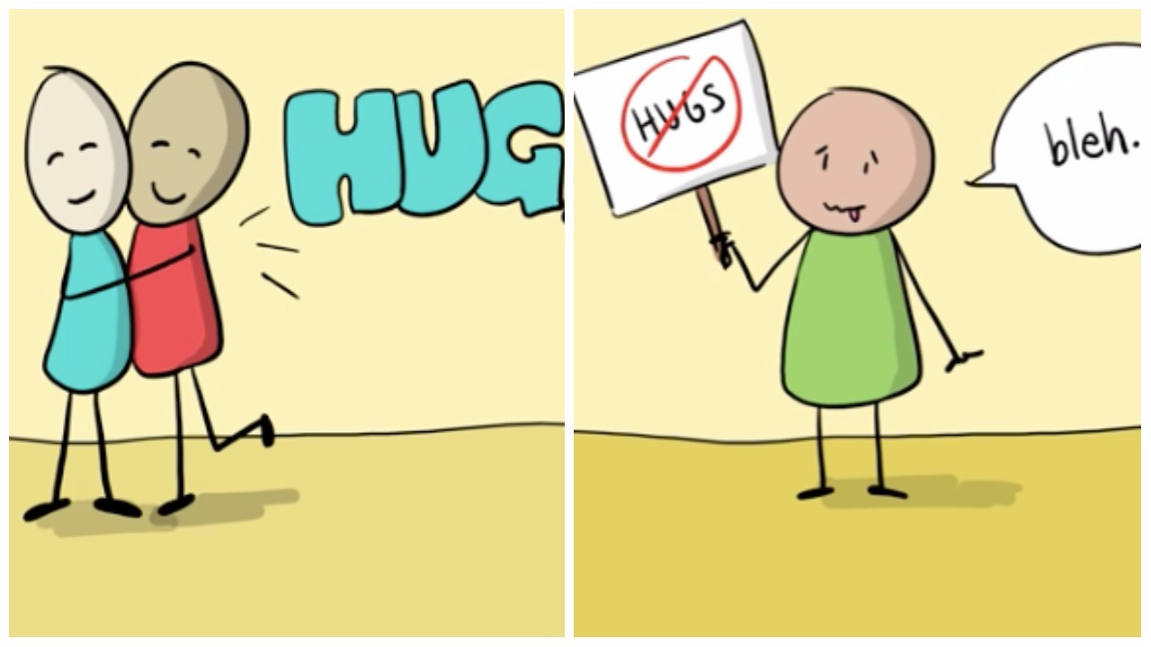
What is consent?
If someone consents to sex, it means they agree by choice, and also that they have the freedom and capacity to make that choice. Capacity is being able and well enough to understand the decisions being presented to you i.e. not having your judgement impaired due to drugs or alcohol.

Slide 10
Sex and the law
What is the age of consent for sex?
The age of consent for sex is 16, meaning people aged 16 and above can consent to sexual activity.
If you're under 16, you can still get confidential advice, and access contraceptive and sexual health services.
If you're under 13, the situation is different because the law says you cannot consent to any sexual activity at this age.

Slide 11
What is consent?

Slide 12
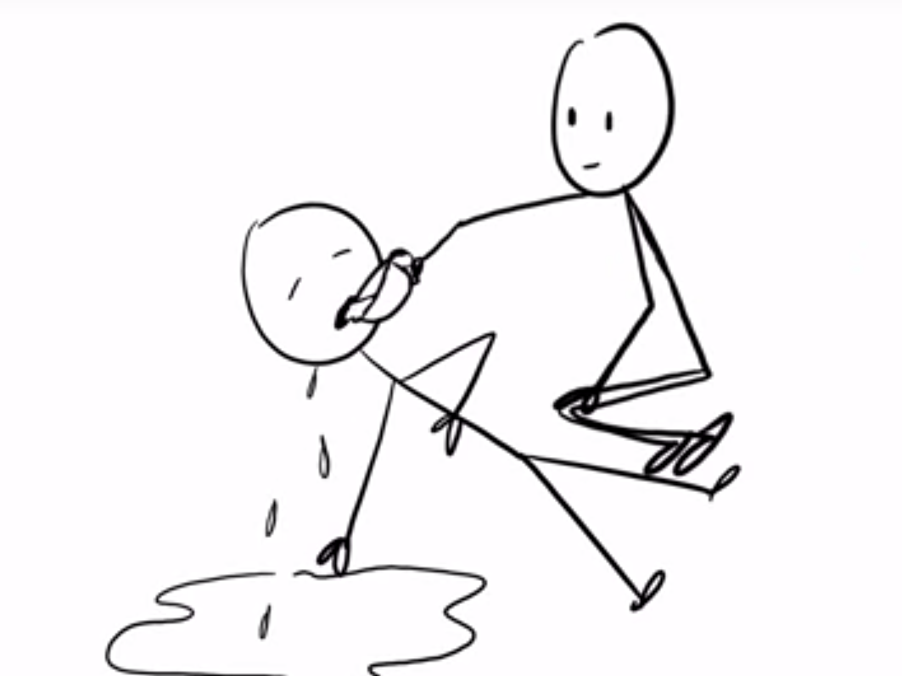
Consent and Tea
https://www.youtube.com/watch?v=fGoWLWS4-kU
Notes:
Can use any other materials to talk through this too as tea and consent it very well known.

Slide 13
Myth or Fact?
If somebody said yes to sex using a condom, and you took it off half-way through, do you still have their consent?
If a person does not say ‘no’ or fight back when you try to have sex with them, have they given their consent?
If a person is asleep when you start having sex with them, have they given their consent for you to have sex with them?
Two people have had sex with each other before, do they still need to ask for consent?
You can be sexually assaulted by your husband / wife / partner.
Legal explanations are below
Notes:
If someone takes a condom off during sex without the others consent and carries on it is considered sexual assault as the conditions that were previously agreed have changed.
People should seek consent for every new sexual act, not saying no does not always mean a person is comfortable.
https://www.met.police.uk/advice/advice-and-information/rsa/rape-and-sexual-assault/what-is-rape-and-sexual-assault/

Slide 14
Myth or Fact?
Under 16s cannot consent to have sex.
Girls that flirt and wear sexy clothes are leading men on and ‘asking for it’.
It is not possible to give consent when you are drunk.
Once a man is sexually aroused he cannot help himself. He has to have sex.
You only need consent when it comes to sexual intercourse.
Notes:
https://www.fpa.org.uk/factsheets/law-on-sex#:~:text=Scotland-,The%20age%20of%20consent%20to%20any%20form%20of%20sexual%20activity,16%20is%20a%20criminal%20offence.&text=Sexual%20intercourse%20(vaginal%2C%20anal),even%20if%20both%20partners%20consent.

Slide 15
Body language

Slide 16
Body language

Slide 17
What if consent is not given?
Sexual contact without consent from both parties is considered sexual assault or rape.
Both people must agree to every new act AND the way in which it is done (i.e. with a condom).
How do I get consent?
Ask questions - ‘can I take your clothes off?’ ‘Is this ok?’
Be aware of their body language – are they into it? If you’re not sure – you need to check!

Slide 18
What if they kept going without my consent?
Get support - consider telling someone what has happened, e.g. your parents, a close friend.
Contact a sexual assault referral centre (SARC) – There are three in London called the Haven centres and you can make an appointment at this website: https://www.thehavens.org.uk/visiting-us/ - They will not pressure you to report to the police. - They can support you. - The support is completely confidential.
Valuable DNA evidence can be collected up to 7 days after the assault..

Slide 19
Activities to teach consent
Free website
https://www.dosreforschools.com/how-do-can-help/do-for-school-leaders/lesson-plans-and-stimulus/
Book with 200+ activities for educators working with young people - £30.63
https://www.amazon.co.uk/Relationships-Education-Lesson-Ideas-Century/dp/0815393636
Free online course with Brook
https://www.brook.org.uk/product/consent-course/
Childline
https://www.childline.org.uk/searchpage/?query=consent
Padlet with links to a lot of resources
https://padlet.com/sharondavies1/sx3v2f1dc4tjjo11

Slide 20
Sexually transmitted infections (STIs)
Sexually transmitted infections can be acquired through sexual contact, exchanging sexual fluids and by skin to skin contact. Some can be passed on through blood.
Young people have some of the highest rates of STIs than any other age groups. This is for many reasons including:
Lack of skills and confidence to negotiate safe sex
Lack of awareness about STIs, contraception, safe sex practices & sexual health services

Slide 21
How are STIs passed on?
Unprotected sex (vaginal and anal)
Oral sex
Sharing sex toys
Through sexual touching
Skin to skin contact (genital warts, genital herpes, pubic lice)
Mum to baby during birth
Intravenous drug use (sharing needles for hepatitis and HIV)
Notes:
Although it can be difficult talking though each of the sexual acts through which people may catch STIs going through them all explicitly is LGBTQ inclusive and helps people who engage in sexual acts other than just penetrative penis and vagina sex that protection is still important.

Slide 22
Myths about STIs
I can only get an STI if I have sex.
I don’t sleep around so I am safe.
Oral contraceptives protect against STIs.
If I don’t have symptoms I can’t spread it.
All STIs can be cured with medication.
I’m too young to get an STI.
You can get an STI from sitting on a toilet seat.
I cannot have an STI as I have no symptoms.
Only gay men catch HIV.
I am a lesbian so I cannot catch an STI.
Notes:
Can catch an STI from other sexual acts other than just penetrative sex
Lottery example – you can win the lottery by buying one ticket but if you buy 1000 your chances go up
Oral contraceptives protect against pregnancy
Many STIs show no symptoms and are still transmissible
Not all STIs can be cured with medication
STIs are not exclusive to adults anyone can get one
Cannot get an STI from sitting on a toilet seat virtually impossible but this still gets a lot of debate
HIV is transmissible to all people not just gay men
STIs can be transmitted from woman to woman

Slide 23
Sexually Transmitted Infections
Bacterial | Parasitic | Viral
Curable | Curable | Treatable/Manageable
Chlamydia | Pubic lice/Crabs | HIV
Gonorrhoea | Trichomoniasis | Herpes
Syphilis |  | Warts
 |  | Hepatitis B
Testing window period: Around 2 weeks | Testing window period: Around 4 weeks | Testing window period: Around 6 weeks
Notes:
Viral infections can be managed with medication but normally will stay in our bodies once they are caught, parasitic and bacterial infections can be cleared with antibiotics.

Slide 24
Types of STIs and what they do to your body?
Chlamydia
Chlamydia is a very common bacterial STI. Bacterial means that a course of antibiotics can clear it up.
Often chlamydia is asymptomatic (this means you will feel no symptoms). For that reason, a lot of people do not know that they have it. This is why testing is so important.
When people have symptoms, they may notice unusual discharge (discharge is fluid leaking from the vagina or penis). They may also feel pain when peeing and pain in their reproductive organs.
If chlamydia is left untreated people can develop bad pain in their reproductive organs which is due to swelling and inflammation. Chlamydia can lead to infertility (infertility is when people cannot have a baby naturally) in men and women.
Notes:
https://new.enfield.gov.uk/healthandwellbeing/stis-2/

Slide 25
Types of STIs and what they do to your body (continued)?
Gonorrhoea
Gonorrhoea is a bacterial STI which can show no symptoms, but when it does have symptoms people may notice unusual green/yellow discharge, pain when peeing. Women may have bleeding in between periods.
Left untreated gonorrhoea can cause bad pain and infertility for men and women.
Syphilis
Syphilis is a bacterial infection that causes a painless but highly infectious sore on your genitals or sometimes around the mouth. The sore lasts two to six weeks before disappearing.
Secondary symptoms, such as a skin rash and sore throat, then develop. These may disappear within a few weeks, after which you have a symptom-free phase.
If diagnosed early, syphilis can be easily treated with antibiotics, usually penicillin injections. if it is left untreated, syphilis can go on to cause serious conditions such as stroke, brain damage, paralysis, blindness or death.
Pubic lice
Pubic lice (‘crabs’) are tiny insects that live in human body hair, most commonly pubic hair. They cause itching and red spots.
They can usually be successfully treated with cream, lotion or shampoo available over the counter in most pharmacies, or from a GP or the sexual health clinic.

Slide 26
Types of STIs and what they do to your body (continued)?
Trichomoniasis
Trichomoniasis causes soreness and Types of STIs and what they do to your body (continued)?
Herpes
Genital herpes is a part of the herpes zoster family of viruses (this is a group of mostly harmless but painful viruses). This causes chickenpox, shingles, cold sores and genital herpes.
There are two types of herpes strains which can be caught genitally (and sometimes orally). These are herpes simplex virus type 2 (HSV-2) the genital herpes strain and herpes simplex virus type 1 (HSV-1) the oral herpes strain, sometimes but less frequently HSV-2 is caught orally.
Herpes can be treated with anaesthetic creams and antiviral medication.
Hepatitis B
Hepatitis B is an infection of the liver caused by a virus that's spread through blood and body fluids. It is usually cleared by the body’s immune system without treatment, if it persists for years it may eventually cause serious liver damage.
It is less common in the UK.
There is a vaccination for hepatitis B.

Slide 27
Types of STIs and what they do to your body (continued)?
Genital Warts
Genital warts are caused by the human papilloma family of viruses (HPV).
Two strains of HPV cause genital warts, these are known as low risk strains. Genital warts are harmless fleshy growths that grow on the genital and anal area.
There is a vaccination for HPV.

Slide 28
Types of STIs and what they do to your body (continued)?
HIV (Human-immunodeficiency virus)
HIV is a virus most commonly caught by having unprotected sex or by sharing needles.
HIV can develop into acquired immunodeficiency syndrome (AIDS) if left untreated, this is the final stage of the HIV infection. This means your body can no longer fight infections.
There’s no cure for HIV. However, when caught early through regular testing and treated with antiviral medication, people can live healthy lives.
Taking medication correctly reduces the virus in the body so much, it is as if people do not have it anymore, this is known as becoming undetectable and this means you are no longer infectious.
With modern day advances in technology people with HIV marry and have children with people who do not have HIV and do not pass the virus on to their partner or children. HIV transmission can be prevented with regular testing, medication and correct usage of condoms.
People who may have been exposed to the HIV virus can take PEP (post- exposure prophylaxis) within 72 hours of the suspected exposure, to prevent catching it. This is a potent medication that may be accessed if necessary from A&E departments or sexual health clinics.

Slide 29
Symptoms
Most STIs asymptomatic i.e. do not have symptoms.
Some symptoms can include:
Unusual or excess discharge
Bleeding between periods
Bleeding during or after sex
Testicular pain
Bad smell
Lower abdominal pain
Pain when weeing or during sex
Rash or itching
Genital warts
Open genital or oral sores
Fevers, flu-like symptoms
Throat infections
If someone has had sex recently and not been tested and has any of the symptoms mentioned it would be a good idea to get a test.

Slide 30
How do I avoid getting an STI?
Use a condom for vaginal or anal sex
Use a condom or dental dam for oral sex
Get tested with your partner before any unprotected sexual contact
Do not share sex toys
Get tested regularly if you are sexually active, and 6 weeks after every new partner
Notes:
Include a link

Slide 31
How to use a condom?
Notes:
If you would like leaflets with this information please ask.
To buy condom demonstrators go to https://fpa.org.uk/product/condom-demonstrator-pack-condoms

Slide 32
How to use a condom?
98% effective when used correctly
Check the expiry date
Check the packaging has the two marks below this means they are of the appropriate manufacturing standards
Check the package isn’t damaged
Carefully open the packet
Put it on the right way around (the right way around is when the condom looks like a sombrero).
Make sure there’s no trapped air
Only use water-based lubricants – no oils (i.e. Vaseline, baby oil).
Notes:
If you can do a condom demo i.e. have a demonstrator and condoms this is ideal but if you do not there are plenty of options here.

Slide 33
This is a sombrero
Notes:
https://new.enfield.gov.uk/healthandwellbeing/stis-2/
https://www.youtube.com/watch?v=9jRhPFVTYLU

Slide 34
Activities to teach STIs or signposting
Free website
https://www.brook.org.uk/topics/stis/
Activity to show how easy STIs spread
https://www.tes.com/teaching-resource/activity-exploring-spread-of-sti-s-including-hiv-6120991
Book with 200+ activities for educators working with young people - £30.63
https://www.amazon.co.uk/Relationships-Education-Lesson-Ideas-Century/dp/0815393636
Childline
https://www.childline.org.uk/info-advice/friends-relationships-sex/sex-relationships/sexually-transmitted-infections/
Padlet with links to a lot of resources
https://padlet.com/sharondavies1/sx3v2f1dc4tjjo11

Slide 35
Services in Enfield
Clinics in Enfield:
https://www.echoclinics.nhs.uk/
Order online testing kit:
https://www.shl.uk/
Sexual health information at:
https://www.enfield.gov.uk/healthandwellbeing/sexual-health
Condom scheme information
https://www.enfield.gov.uk/healthandwellbeing/sexual-health/condom-scheme

Slide 36
For more information….
For ANY RSE, sexual health and C-Card related queries email sexualhealth@enfield.gov.uk

